Slide 1

FEEDBACK COLLECTION SYSTEM
AKSHAY S

Slide 2

Aim of the project
Problem Statement
Project Description
Functionalities
Input Versatility with Error Handling & Exception Handling
Code Implementation
Result
Conclusion
AGENDA

Slide 3
AIM OF THE PROJECT
The primary objective of the project is to develop a comprehensive feedback collection system that enhances user engagement and satisfaction. The main goals include:
Developing a Comprehensive Feedback Collection System.
Streamlining Feedback Collection Process.
Improving Overall User Satisfaction.
Providing a Centralized Platform for Managing Feedback.
Feedback Attributes
Validation and Error Handling
Feedback Storage

Slide 4
PROBLEM STATEMENT
Manual Feedback Collection
Data Handling Issues
Need for Modernization
Communication Breakdowns
OVERVIEW OF THE PROJECT
Automated Feedback Collection
Enhanced Communication Channels
Centralized Information Management
User-Focused Design
Modernization of Educational Administration

Slide 5
PROJECT DESCRIPTION
The project involves developing a feedback collection system using Python, focusing on core functionalities to streamline the process of gathering feedback, enhancing communication, and improving overall efficiency in managing feedback data.
SCOPE
The Feedback Collection System project aims to develop an efficient, user-friendly platform for collecting, managing, and analysing feedback from various stakeholders in an educational environment.

Slide 6
TECHNOLOGIES & METHODOLOGIES
Programming Language: Python 3
Data Structures: Lists and dictionaries to store and manage feedback data.
Regular Expressions (re): For email validation to ensure correct email formats.
File Handling: To save feedback data to a text file for long-term storage and retrieval.
Exception Handling: To manage and provide informative error messages for invalid inputs.
Modular Design: Using classes and functions to encapsulate different functionalities and ensure maintainability and scalability of the system.

Slide 7
FUNCTIONALITIES
Automated Feedback Collection
Subject-Specific Feedback
Feedback Data Management
Performance Rating
Enhanced Communication
Data Validation and Error Handling
Feedback Persistence
User-Friendly Interaction
Staff Selection
Review and Analysis

Slide 8
INPUT VERSATILITY WITH ERROR HANDLING & EXCEPTION HANDLING
Name Validation
Email Validation
Performance Rating
Subject and Staff Selection
Comprehensive Input Validation
Handling Additional Feedback Submission
CODE IMPLEMENTATION
To implement the project, we utilize basic Python programming concepts to create a modular and maintainable codebase. We leverage key algorithms and data structures to efficiently manage data processing tasks.

Slide 9
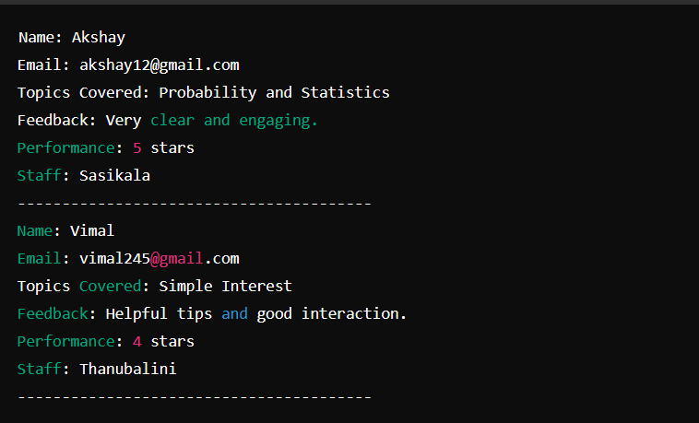
RESULT

Slide 10
CONCLUSION
The developed feedback collection system effectively streamlines the process of gathering, managing, and analysing feedback from students. The program ensures data integrity through robust validation and exception handling mechanisms. By categorizing feedback based on different subjects and respective staff members, it provides a clear and organized way to track performance and areas for improvement.

Slide 11


